Slide 1
NATIONAL SKILLS CONFERENCE 2021 REPORTS COMMISSION 1: PROMOTING HIGH-IMPACT AND CUTTING-EDGE TECHNOLOGICAL OCCUPATIONS FOR CURRENT AND FUTURE INDUSTRIES 29 September 2021

Slide 2
COMMISSION BACKGROUND
Aimed at tracking and profiling the role of 4IR in shaping the skills development system agenda.
Strengthening the skills development system through sound planning, research, monitoring and evaluation.
The commission objectives were:
Digitalisation by small businesses and informal sector,

Slide 3
COMMISSION BACKGROUND
Inclusivity and transformation in addressing the skills gaps in light of 4.0 changes,
Innovation and Entrepreneurship Opportunities for South Africa’s Youth within the 4th Industrial Revolution,
Best practices and strategies for meeting the needs of vulnerable and disadvantaged youth (e.g. NEETs),
Use of new technology by cooperatives and communities for advancing skills development programs,

Slide 4
COMMISSION PRESENTATIONS
The commission dealt with two broad areas, with two presentations in each, namely:
Transitioning into future skills: Systematic response to digital skills for South Africa
Catalysing the Inclusion of Persons with Disabilities through Digital Innovation for Disability Inclusion (Digi4DI)
Realities of a new digitised world towards a stronger PSET South African system

Slide 5
COMMISSION PRESENTATIONS
Skills Planning, monitoring and research for system: Supporting and monitoring the capacity of the skills development system
Readiness of the local metal industry for the Fourth Industrial Revolution – implications for skills development
Promoting High-impact and cutting-edge technological occupations for current and future industries

Slide 6
PRESENTATION 1:
Catalysing the Inclusion of Persons with Disabilities through Digital Innovation for Disability Inclusion (Digi4DI)
The presentation was about:
Inclusion of people with disability being seen as a priority in a work setting.
Outlining strategies to build an inclusive digital environment and championing inclusivity at organisational level.
The recommendation was that digitalisation should be used as an enabler for PWD without the need for physical being in an office setting - this will reduce employers’ limitation in infrastructure investment for inclusion

Slide 7
PRESENTATION 2: Realities of a new digitised world towards a stronger PSET South African system
The presentation mapped out the challenges posed by digitalisation and how these impact or influence South Africa’s Post School Education and Training system.
It introduced interoperability where PSET CLOUD, which is a digital platform, enables users to share and use data for decision-making and promote a more efficient and responsive post-school education system.
The recommendations were as follows:
Develop relevant skills as required by the market in line with the skills demands in the 4IR era and adopt an action plan
Promote lifelong learning where people can continuously reskill and upskill themselves

Slide 8
PRESENTATION 3: Readiness of the local metal industry for the Fourth Industrial Revolution – implications for skills development
The presentation dealt with 4IR readiness and implications for skills development.
The focus was on 4IR components, technology as a change driver as well as paradigm shifts in the labour market.
He introduced a trend of acquiring micro credentials

Slide 9
PRESENTATION 3: Readiness of the local metal industry for the Fourth Industrial Revolution – implications for skills development
The recommendations provided included:
Partner with stakeholders involved in digitalisation to enable the country to fast track the information era
Focus on more short-term intervention programmes, to respond to ever changing labour market
Consider TV and radio broadcasting as a platform for education and learning, especially for rural communities
Create Digital hubs in community centres, libraries, education and training centres with free access to WiFi for education and learning purpose

Slide 10
PRESENTATION 4: Promoting High-impact and cutting-edge technological occupations for current and future industries
The presentation sought to demonstrate:
The challenges Africa, as a continent, will face if it fails to respond adequately to the 4IR.
Parallels were drawn with Asia, which is currently among the leaders in technological advancements.
The presentation encouraged processes and infrastructure implementation to ensure accessibility to technology.
He shared an example of Asia, its model, and 10-year journey in being a game changer in achieving digital advancements

Slide 11
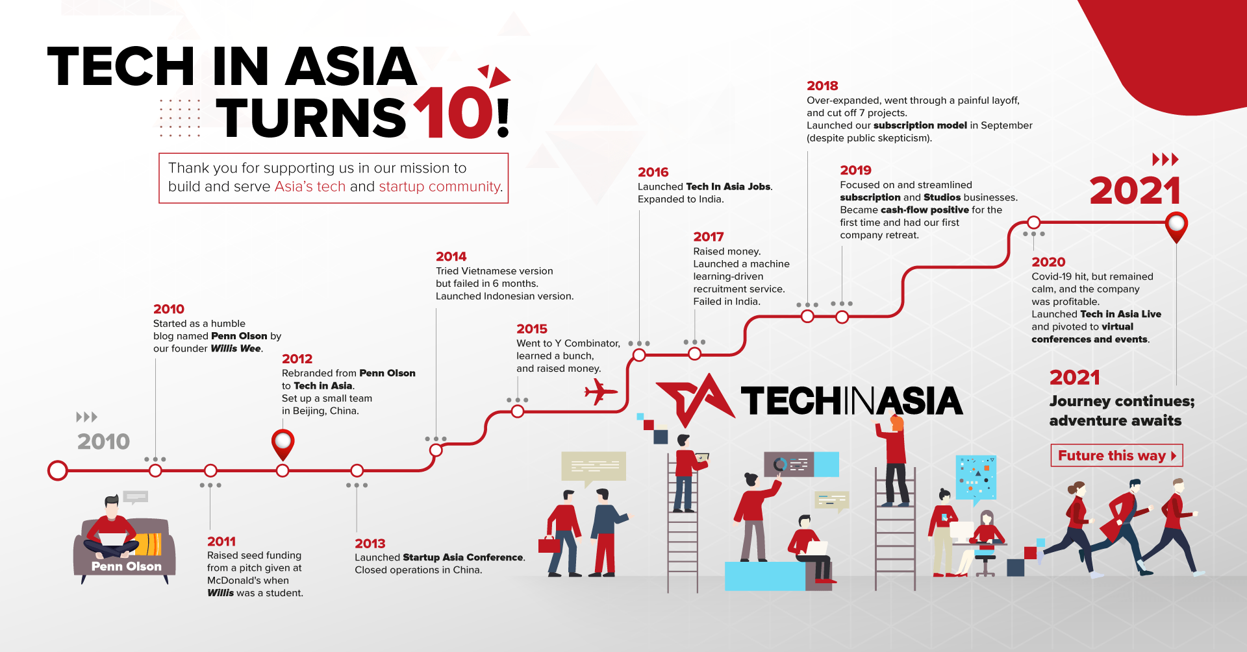
PRESENTATION 4: ASIA EXAMPLE
The Recommendations was for a national call for Digital transformation and certification, with clear short, medium and long term targets to achieve information revolution, be adopted.

Slide 12
Thank You
NATIONAL SKILLS AUTHORITY www.nationalskillsauthority.org.za

