Slide 1
Enhancing collaboration to build successful TVET systems
September 2021

Slide 2
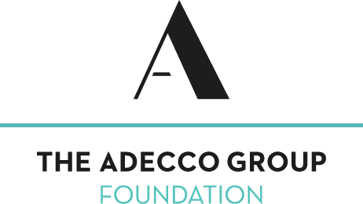
GAN Global Members & Partners

Slide 3
THE FOCUS
“Strengthening international and local collaborations for an impactful vocational education and training system”..
PPPs in TVET can be identified as “a formal relationship with shared responsibilities between public and private sector actors in co-operation to achieve mutual goals that may take the form of a joint business venture, a joint education and training agreement, or a social partnership structured around a social agenda” ...UNESCO
Quality TVET is also recognized to be a key for enhancing economic competitiveness and for contributing to social inclusion, decent
employment and income, and poverty reduction (Association for the Development of Education in Africa [ADEA], 2008).

Slide 4
What is needed to improve the system?
Creating opportunities for WBL, LLL & labour market linkages
Designing responsive WBL Solutions for Decision Makers
Priorities
Influencing & creating an enabling policy environment
Research & advocacy to create a strong knowledge platform
Driving the Acceleration of WBL by the private sector

Slide 5
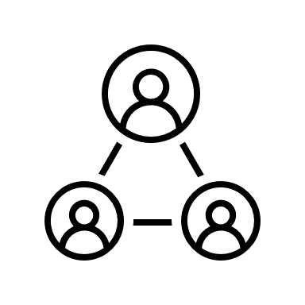
Project delivery and focus
Green Skills focus
International TVET system review
Country level policy analysis
Policy and advocacy work + career guidance
Future of Work and Work-based learning
Current projects

Slide 6
The role of partnerships
Driving innovation and digitalization in the skills development ecosystem and contributing towards a responsive future of inclusive growth

Slide 7
Co-creating impact
As a unique business-driven and CEO-led multisector alliance, GAN rolled out the following strategy, which allows us to convene and leverage the experience, knowledge and networks of global and community corporate leaders and policy-makers.
GLOBAL POLICY AND ADVOCACY: Build on the global network and relationships with business organizations (employer representatives), private sector companies and working with multilateral policy organizations to advocate and shape for responsive TVET systems and frameworks
TECHNICAL INSIGHT: GAN provides technical insight on WBL and apprenticeship related topics.
ADVOCACY AND PEER-TO-PEER NETWORKING: learn about current issues through discussion and engagement with other top companies and organizations, all with global outreach (including the ILO, the OECD and the G20/B20 structures, the Commonwealth, the African Union, the European Union and other partners)
COLLABORATION ON JOINT INITIATIVES to accelerate skills acquisition and build a sustainable talent pipeline
NATIONAL UNDERSTANDING: Access to local country networks to meet local market needs while seeking out and anticipating trends, changes, threats and opportunities

Slide 8
mannie@gan-global.org
www.gan-global.org
@GAN4Skills
GAN 4 Skills
@GAN4Skills

