Slide 1
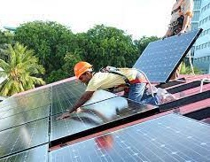


Skills for a Just Transition to a Green Economy – the Policy Context & Progress
Prof Eureta Rosenberg | Rhodes University Environmental Learning Research Centre | Makhanda | E.Rosenberg@ru.ac.za

Slide 2
Contents
The Relevance of a Green Economy
  Concerns
  Opportunities
Associated jobs and enterprises – in 4 realms
Policies driving green growth and skills needs
Skills policies to guide green skills planning
Skills planning challenges and selected progress examples

Slide 3
Why Green the Economy?

Slide 4
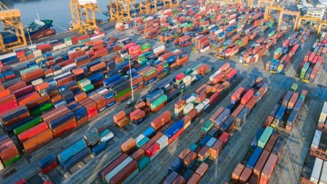
We’re in the dark
Running out of water
Failing to create jobs
And at risk of losing out (US Green Economy at $1.4 trillion)

Slide 5
Green Jobs & Enterprises

Slide 6
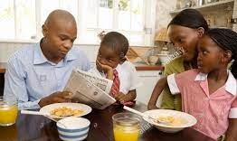
4 Realms of the Economy
Economy
Households
Governance
Markets
Commons
Raworth, K. 2017. Doughnut Economics. How to think like a 21st century economist. Random House Business Books, London.

Slide 7
4 Realms of the Economy
Jobs and Enterprises in a Green Economy
Households: Food gardeners, farmers, recyclers, repair shops, water leak technicians, community conservancies, ...
Governance: Working for Water, Working on Fire, Working for the Coasts, Working for Ecosystems, Green Scorpions, nature conservators, game guards, climate scientists, resource economists, policy makers ...
Markets: Green finance, carbon bonds & taxes, electric vehicles, solar panel installers, wind turbine technicians, green building constructors, engineers & artisans, eco-tourism operators
Commons: Renewable energy, wetland reconstructors, beach cleaners, acid min restoration, insurance, Enviro-Champs ...
green
Raworth, K. 2017. Doughnut Economics. How to think like a 21st century economist. Random House Business Books, London.

Slide 8
Policies Driving Green Growth & Skills Needs

Slide 9
Policies driving green growth and skills needs
The Republic of South Africa 1996 Constitution
National Strategy for Sustainable Development
The National Development Plan 2030: Our future – make it work
The New Growth Path 2020: Green Economy Accord 2011
Climate Change Response Strategy (2020)
Section 24 (b) of the Constitution: “secure ecologically sustainable development and use of natural resources while promoting justifiable economic and social development.”
Supported by various sectors’ legislation and policies

Slide 10
Policies driving green growth and skills needs
The Republic of South Africa 1996 Constitution
National Strategy for Sustainable Development
The National Development Plan 2030: Our future – make it work
The New Growth Path 2020: Green Economy Accord 2011
Climate Change Response Strategy (2020)
Selection and implement a development option, which allows for appropriate and justifiable social and economic goals to be achieved, based on the meeting of basic needs and equity, without compromising the natural system on which it is based
A green economy is defined as low carbon, resource efficient and socially inclusive. In a green economy, growth in employment and income are driven by public and private investment into such economic activities, infrastructure and assets that allow reduced carbon emissions and pollution, enhanced energy and resource efficiency, and prevention of the loss of biodiversity and ecosystem services. (UNEP)

Slide 11
Policies driving green growth and skills needs
The Republic of South Africa 1996 Constitution
National Strategy for Sustainable Development
The National Development Plan 2030: Our future – make it work
The New Growth Path 2020: Green Economy Accord 2011
Climate Change Response Strategy (2020)
NDP2030: Chapter 5: Environmental sustainability and the transition to a low-carbon economy
It is important to sustain SA’s natural resources and use them efficiently
These resources are the basis for South Africa’s social and economic development

Slide 12
Policies driving green growth and skills needs
The Republic of South Africa 1996 Constitution
National Strategy for Sustainable Development
The National Development Plan 2030: Our future – make it work
The New Growth Path 2020: Green Economy Accord 2011
Climate Change Response Strategy (2020)
SA’s Green Economy Accord, one of the most comprehensive social pacts on green jobs in the world, was a partnership to create 300 000 new jobs by 2020, in economic activities as diverse as energy generation, manufacturing of products that reduce carbon emissions, farming to provide feedstock for biofuels, soil and environmental management and eco tourism. E.g. commitment to install one million solar water-hearing systems. Investment in shifting freight from road to rail.

Slide 13
Policies driving green growth and skills needs
From the Desk of the President: “The Economic Reconstruction and Recovery Plan that we launched in October last year has several measures to drive business and job creation in green industries, and our Integrated Resource Plan 2019 envisages the building of renewable energy capacity that can produce over 17 gigawatts of electricity by 2030” (April 2021)
The Republic of South Africa 1996 Constitution
National Strategy for Sustainable Development
The National Development Plan 2030: Our future – make it work
The New Growth Path 2020: Green Economy Accord 2011
National Climate Change Adaptation Strategy (DFFE, 2020)
Signatory to the Paris Agreement to combat climate change
Ramaphosa (Aug 2020): “we should not merely return to where we were before the pandemic struck. We are instead looking at actions that will build a new, inclusive economy that creates employment and fosters sustainable growth. An important aspect of this new economy is that it must be able to withstand the effects of climate change. A climate-resilient economy is necessary to protect jobs, ensure the sustainability of our industries, preserve our natural resources and ensure food security”

Slide 14
Policies driving green growth and skills needs
Strategic Macro-economic policies
New Growth Path: Green Economy Accord and NDP 2030
National Strategy for Sustainable Development
Enabling Sectoral Policies
Industrial Policy Action Plan
Bio-fuels and Bio-economy
Incentivising & Mandatory Policies
Environmental Fiscal Reforms e.g. fuel levy, plastic bag levy, carbon tax
Environmental tax breaks e.g. energy efficient tax incentive regulations
National Climate Change Response Strategy [and NSDS III]
White Paper on Renewable Energy
National Transport Master Plan
Roadmap for EV in SA
National Building Regulations and Building Standards
Presidential Employment Stimulus
Adapted from; Mohamed, N. & Ramsarup, P. 2020. Green economy transitions and skills. Global and South African perspectives.

Slide 15
Skills Policy Response
Are we ready to produce the skills needed? What guides us?

Slide 16
Policies & strategies guiding (green) skills planning
White Paper on Education and Training (1995)
Environmental Sector Skills Plan (DEA, 2010)
Biodiversity Human Capital Development Strategy (SANBI, 2010);Global Change Grand Challenge HCDS (DST, 2010) and others
Curriculum and Assessment Policy Statements (CAPS) (DBE, 2012)
National Development Plan 2030: “A capable state”
The National Skills Development Strategy (DHET)
The National Skills Development Plan (DHET, 2019)

Slide 17
Policies & strategies guiding (green) skills planning
White Paper on Education and Training (1995)
Environmental Sector Skills Plan (DEA, 2010)
Biodiversity Human Capital Development Strategy (SANBI, 2010);Global Change Grand Challenge HCDS (DST, 2010) and others
Curriculum and Assessment Policy Statements (CAPS) (DBE, 2012)
National Development Plan 2030: “A capable state”
The National Skills Development Strategy (DHET)
The National Skills Development Plan (DHET, 2019)
“The New Growth Path (NGP) emphasises the importance of skills development and ... looks to the National Skills Development Strategy (NSDS) for guidance. This challenge translates into a question: What skills are required for the implementation of its five main job drivers: 1. Substantial public investment in infrastructure both to create employment directly, in construction, operation and maintenance as well as the production of inputs, and indirectly by improving efficiency across the economy; 2. Targeting more labour-absorbing activities across the main economic sectors – the agricultural and mining value chains, manufacturing and tourism and high-level services; 3. Taking advantage of new opportunities in the knowledge and green economies; 4. Leveraging social capital in the social economy and the public services; and 5. Fostering rural development and regional integration.“ (p.13)

Slide 18
Skills enable just transitions
Truck driver
Train driver
Station master
Mine worker
Restoration worker
Nursery owner
Plumber
Leaks repairperson
Grey water specialist
“Green skills identification, anticipation and planning are vital to extract the full employment-creation benefits from green economy transitions. This requires integration of green skills development in national skills planning systems, alignment of skills development with environmental policies and coordination between employers, policymakers, educational institutions and labour”
(Mohamed & Ramsarup,
2020, p.27)

Slide 19
Green Economy Skills Planning
Remaining Challenges and Selected Progress Examples

Slide 20
Limited alignment through-out the system
Green Economy policies but weak skills components and lack of skills policies
Where policies mention green skills, there is a lack of labour market analysis – what skills do we need, where and how many?
Where skills research is done, there is no follow-through to develop skills (NSDS Evaluation, 2019)
No mechanism for planning for cross-cutting concerns (NSDS Evaluation, 2019)
Lack of a systemic approach (e.g. taxonomy bursaries but no-one wants to work in a museum)
Some systemic programmes but limited resources to implement (e.g. Biodiversity HCD Strategy)
Where skills are developed, the jobs may be gone (national renewable energy strategy)
“Environmental skills planning is ad hoc and inadequate” (ESSP, 2010)
Need for greater coherence – e.g. regional (social) skills ecosystems. Lotz-Sisitka, H. 2020. Probing the potential of social ecosystemic skills approaches for green skills Planning: Perspectives from EPWP studies.

Slide 21

Progress through Covid19 – Providers & Partners go Online
Migrating to online platforms & maintaining partnerships
Rhodes ELRC – 1025 students online in 2021
“Training of Trainers” courses with Wits University, North West University, Rhodes, Energy and Water SETA, ...
Online conferences - Environmental Education Association of Southern Africa Conference hosted by Mauritius Chapter
ESD ExpertNet partnership with Engagement Global, Federal Ministry for Economic Cooperation and Development (Germany) addressing need for mentors, course leaders, ESD uptake & evaluation

Slide 22
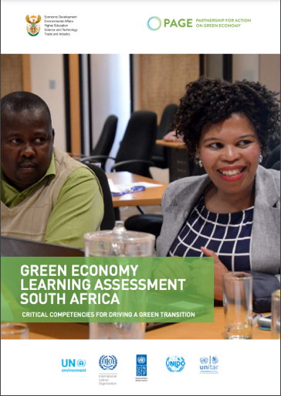
Skills Planning Progress - Collaboration
PAGE (Programme of Action on the Green Economy) + DEA (Environmental Affairs) + DST (Science and Technology) + DHET (Higher Education and Training)
Water Research Commission + DSI (Science and Innovation) + Water Sector Partners + Graduates [linking employers & unemployed]

Slide 23
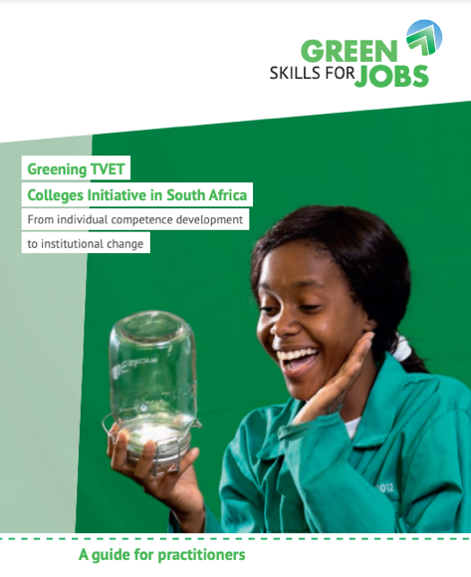
Skills Planning Progress – Guidelines published
Whole Institution Approach – Guidelines for TVET Colleges
Green the curriculum
Preparation for green work
Green the campus and resource use
Outreach to communities
Research to guide sustainability practices and curriculum (e.g. Ramphinwa, 2021; Mkaza, 2021)

Slide 24
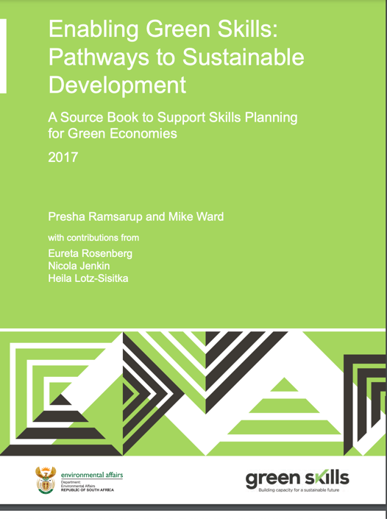
Skills Planning Progress – Guidelines published
UNESCO-UNEVOC will be developing these green skills planning tools into online resources for international distribution

Slide 25
Thank you! How to take this forward?
Many, many more examples of progress could have been shared. But skills planning challenges remain for this relatively ‘new’ direction in skills development.

