Slide 1
Partnership opportunities
JET is the leading NPO in the education and training sector with 26 years’ experience working with government, unions, professional bodies (such as SACE) and also the private sector
Partnership between an NPO (JET) and a for-profit (IOA) unlocks opportunities that cannot be accessed individually
JET’s research, implementation and M&E can complement the work of IOA
JET has a national, African and Middle-East footprint
JET’s Level 2 B-BBEE and Section 18A status allows for the monies paid to JET to be reinvested by the for-profit company
NATIONAL SKILLS CONFERENCE “Skills Pathways and Opportunities” Carla Pereira,
14 March

Slide 2
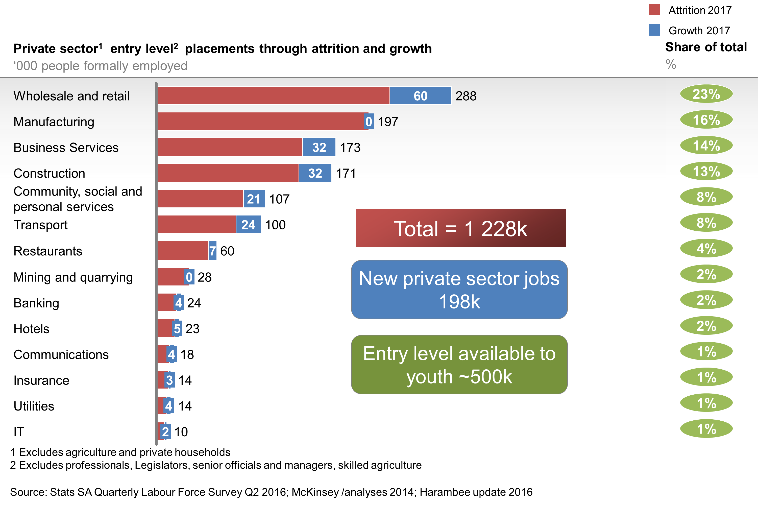
There are 1.2million jobs in the Labour Market

Slide 3
Youth are getting stuck on their paths to the labour market

Slide 4
Problem Statement
43% of the 1 million youth entering the labour market each year get stuck within 6 months and only 6% reach the formal sector
Around R41billion spent annually through government grants, incentives and programmes to address these transitions is having little effect
Little of this investment is aimed at addressing the mismatch between supply and demand
The large majority of youth - who are marginalized and at risk - are not benefiting

Slide 5
How do we transform CET and TVET to respond to this problem?
Identify, understand and expand alternative pathways for large numbers of unemployed youth to available labour market opportunities in large companies and SMEs, as well as offering pathways to micro-enterprises.
More effective mechanisms for coordinating the relationship between supply and demand to ensure there is better alignment of the skills being providing and the absorption capacity of industry
Prioritise and build demand-driven, agile curriculum delivery models that responds to employment opportunities and can be replicated and scaled across the CET & TVET sub-systems.

Slide 6
Demonstration projects – new Occupational Pathways
J.P. Morgan NS4Y Pilot in Orange Farm
Nedbank SWH project with Harambee and IOPSA
S4GJ SWH project with IOPSA and short-term insurance industry in Gauteng and Western Cape

Slide 7
Juxtaposing the models
 | NS4Y Pilot | Nedbank Foundation / NBI Pilot | GIZ S4GJ
Target Group | Unemployed youth in informal settlement community. | Unemployed TVET College Graduates. | Employed workers of various ages working in plumbing/related companies who have experience but had not had formal training opportunities.
Approach | Making technical skills accessible to youth in an impoverished community on the outskirts of JHB through a newly established skills centre, managed by a private artisan training provider. | Using an existing public TVET College in the vicinity of industry with additional industry capacity. | Providing employed workers to upskills and gain specialized skills through a local private training provider and public TVET College.
Industry Focus | The intended focus was on both formal and non-formal industries which would easily accessible for the candidates from the informal settlement. | Focused on formal sector SMEs in and around central Johannesburg. | Focused on formal sector employees in the plumbing industry across Johannesburg and Cape Town.
Recruitment / Selection | Recruitment and selection by Harambee | Recruitment and selection by Harambee | Recruitment and selection by participating employers
Curriculum | 12-week technical training curriculum, combining credit bearing (Solar Water) and non-credit bearing (Photovoltaic) units of learning. | 6-week technical training, 5-week work readiness training / entrepreneurship boot and 6-month workplace learning. Comprises 34 credits at NQF level 2. | Approximately 72 hours of knowledge and practical training combined with 80 hours of workplace learning. Comprises 34 credits at NQF level 2.

Slide 8
Recruitment and Selection to match to demand
NS4Y programme was less prescriptive about selection
Risk of youth in Orange Farm applying for the programme because of a lack of alternative opportunities in the community rather than out of a particular interest in the programme
NBI and GIZ programmes explicitly targeted candidates who were either on a pathway to a technical occupation or were already working in the plumbing industry
GIZ programme had the least structured selection process and candidates were generally unclear about whether selection had taken place - many learners could not cope with the mathematics or English requirements of the programme

Slide 9
Curriculum content aligned to industry requirements
Short skills programmes focused on addressing the necessary technical skills that would enable the candidates to perform effectively in the workplace.
All three programmes offered credit bearing skills in Solar Water Heating Installation, which are recognised as industry standard.
The scope of training for both the NBI and GIZ programmes was linked specifically to opportunities in the plumbing industry, the NS4Y programme was limited and did not explicitly offer a pathway to plumbing.
NS4Y and NBI programmes included foundational hand skills prior to the specific green skills training.
GIZ initiative assumed that the candidates would have many of these foundational skills in place but there was variation in the levels of plumbing skills and some learners needed additional content covering basic plumbing.
Despite this, employers on the GIZ programme were happy with coverage - programme introduced learners to changing processes and students were empowered because they now understood how their work fitted into the broader picture.
NBI programme was strengthened by the inclusion of work readiness and entrepreneurship skills - employers (supervisors and mentors) were satisfied with the level of candidate work-readiness

Slide 10
Integration of Theory, Practical and Workplace Learning
While all three programmes set out to provide a combination of institutional (theory and practical) and workplace learning, only the NBI and GIZ programmes achieved this - industry partners determined the programme requirements and were instrumental in selecting and recruiting the participating workplaces
Plans for workplace learning were not fully in place at the start of the NS4Y programme
NBI candidates indicated that more time should be spent on basic handskills, particularly the handling of tools.
NBI programme spent 6 months in workplace learning which was found to be insufficient for optimising the workplace learning opportunity
GIZ candidates struggled to apply their SWH skills in the workplace, majority only applied them in the college.

Slide 11
Employment Outcomes
NS4Y project brought in Junior Achievement to support students towards enterprise development – this was not successful as most candidates were not interested in starting their own business.
Issue of how to create demand for such skills in the Orange Farm context
All NBI students retained by employers or employed in another employer but not applying SWH skills much
Similarly the GIZ candidates mostly went back to what they were doing before the course and did not apply their SWH skills much
Challenge of determining demand for skills upfront so that the programmes could lend themselves to effective pathways into career progression or microenterprise

Slide 12
What must be done
Effective activation and unlocking of demand upfront
Emphasising effective learner recruitment, selection, matching & work readiness
Integration of theory, practical and work-experience components
Important role of the industry in identifying and driving demand and the curriculum (IOPSA was a critical partner in this regard for the NBI pilot)
Local government is a key roleplayer, particularly in township economies, but firm commitments and exit strategies must be established upfront
Sector-level partnerships are important for harnessing resources and opening pathways

Slide 13
What must be done
Structure of workplace learning and the role of workplace mentors must be clearly defined upfront, especially in SMEs
Critical role of programme management and coordination to effectively address both supply and demand and the interface thereof
Programme scale and sustainability
College readiness and capacity requires intensive hands on support over a sustained period
Understanding institutional complexities and the level of support needed
Need upfront agreement on a sustainable funding mechanism which is driven by social partners

Slide 14
www.jet.org.za info@jet.org.za
@JETEdServices

