Slide 1
National Skills Summit 14-15 March 2019
Commission 5, 14 March 2019
Prof Eureta Rosenberg
Rhodes University Chair of Environment and Sustainability Education E.Rosenberg@ru.ac.za
Green Skills & Occupations: Implications for Skills Planning

Slide 2
Realising the Vision
National Development Plan 2030
Green Economy Accord (2011)
Medium Term Strategic Framework
MTSF Outcome 10
MTSF Outcome 5

Slide 3
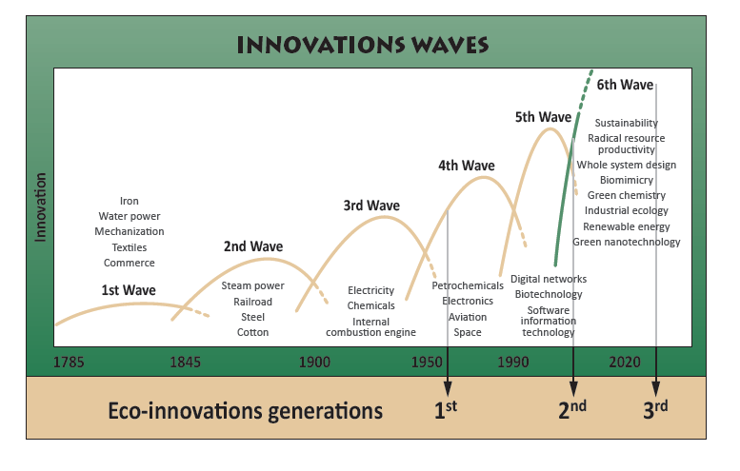
Responding to Risks and Opportunities
From DEA, 2010

Slide 4
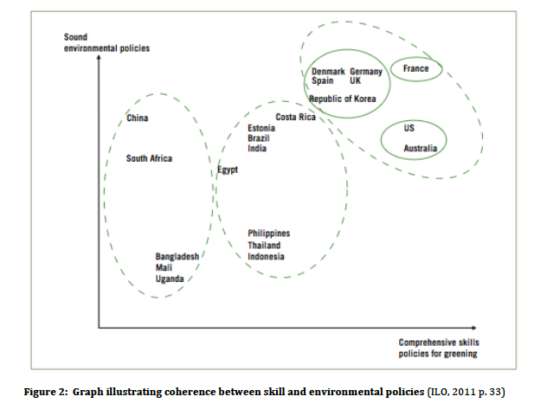
SA Skills policies do not adequately address the need for green skills (ILO, 2010)
No Green Jobs without Green Skills!
”Where is the just transition?” (NUMSA, March 2019)

Slide 5
The Programme

Slide 6
Green Skills (2016-2018)
Project of the National Environmental Skills Planning Forum, working with and drawing on …

Slide 7
Available Occupational and Skills Studies
Environmental Sector Skills Plan (DEA and Rhodes, 2010)
Biodiversity Human Capital Development Strategy (SANBI and the Lewis Foundation, 2010)
Occupational studies to determine demand for green skills in …
coal mining,
paper and pulp industry,
paint,
petroleum,
catalytic converters,
climate smart agriculture,
public procurement (with SETAs)
The Green Economy Learning Assessment for South Africa with PAGE, DEA, DHET, DST,
Amanzi for Food social learning research and skills ecosystem on rainwater harvesting (TVET partners)
Internship evaluations, WBL tracer studies; supply-demand alignment for WIL in conservation sector (WWF)
Occupational pathways studies (environmental engineers, environmental scientists) – Ramsarup, 2018
http://www.greenskills.co.za/ and www.ru.ac.za/education/elrc/ See Hand-Out for academic publications

Slide 8
Insights Gained

Slide 9
Recognising value
Resource Economics
Re-thinking
Circular economies e.g. produce chicken feed from chicken manure
Restoring wetlands, land
Investment e.g. restoration and rehabilitation, e-cars
Auditing e.g. blue drop
Green Financing
Recyling e.g. e-waste
Repairs e.g. water leaks
Re-design e.g. packaging, safe waterless sanitation, zero waste
Re-engineering production & manufacturing processes
Recreating value
Remediating mine waste
Renewable energy
Accounting for nature
Green Occupations & Skills are needed … “Everywhere”
Regulatory Skills

Slide 10
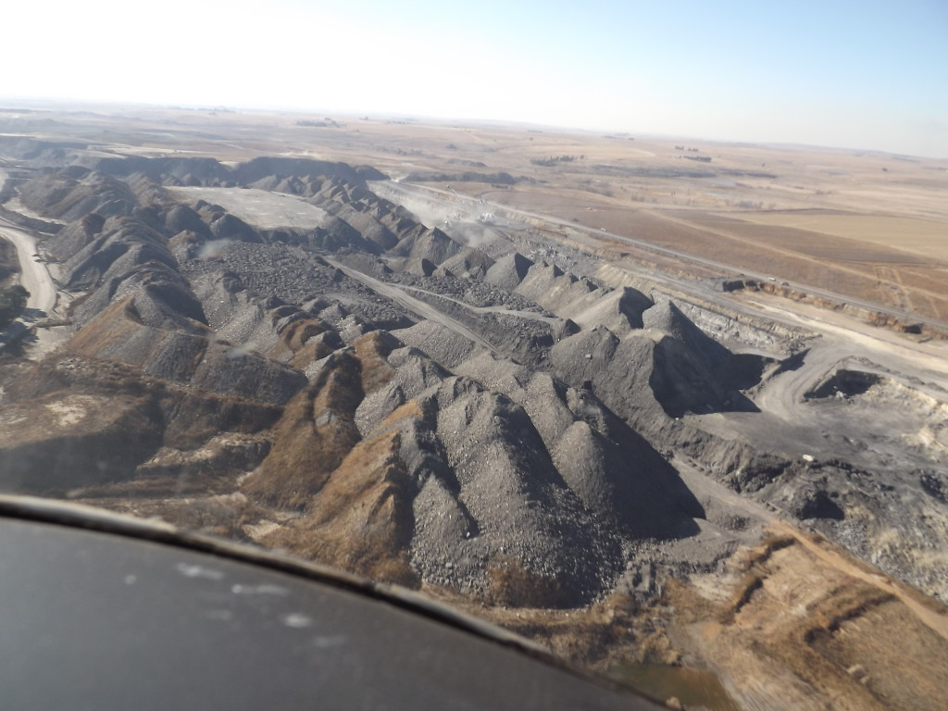
Nevertheless, green skills are not well recognised or anticipated by employers and HR is unable to “name” the occupations (link to OFO)
Photo Credit: CER.
Mpumalanga, 2014/2015
Demand for green skills may remain hidden with conventional planning methods

Slide 11
Use iterative, multi-level methodology
(see Rosenberg, Ramsarup & Lotz-Sisitka, 2019)
Macro level analysis of drivers of skills demand
Sector, system & landscape level analysis
Meso level analysis of Occupations and Skills
Skills Supply - Training and Education
National policy and economic analysis
New technology and development planning, industrial strategy analysis
Value chain analysis, sustainability ‘hot spots’, associated occupations
Mapping qualifications, learning pathways, articulation opportunities, providers
Curriculum analysis in relation to skills needs analysis
Micro-level analysis - Transitioning into Work
* Tracer studies, career stories and vignettes (individual case studies)
Cultural-historical social trends analysis
National and international regulatory frameworks, environmental risk identification
Skills needs analyses for new green jobs and greening existing jobs

Slide 12
Thereafter, prioritisation methods are needed for strategic skills planning
Enhancement of human well-being
Reduction of pollution and waste
Employment & enterprise development
Use multi-factorial analysis to identify the strategic skills ‘sweet spot’

Slide 13
Green work needs multiple competencies … in teams with shared focus
Technical
Trans-formational
Relational

Slide 14
Providers are responding – content + pedagogical innovation
Technical
Competencies
Trans-formational
Relational Competencies
New short courses including MOOCS
Course activated learning networks
Courses incorporating change projects
Courses for teams e.g. manager + staff
Challenge Labs
Work-integrated learning & internships

Slide 15
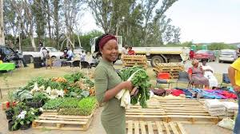
A regional skills ecosystem: Amanzi for Food rainwater harvesting & food production (Lotz-Sisitka, Pesanayi, Matiwani et al., 2018)
University (Rhodes)
Water Research Commission
Lead Farmers
Youth Groups
College (Fort Cox)

Slide 16
The Scale of Skills Planning is Important
The policy landscape is fluid & conflicted
No or little national coordination
Multiple roleplayers needed in the skills ecosystem
Close knowledge of sector is needed
Required skills also sit outside of the sector
Rural region or city focus with strong collaboration
National mechanisms need urgent attention: Resources, further studies, synthesis & coordination mechanism

Slide 17
Thank You!
Prof Eureta Rosenberg
Chair of Environment and Sustainability Education, Rhodes University
E.Rosenberg@ru.ac.za @EuretaRose

