Slide 1


Creating pathways to enhance curriculum outcomes for the 21st Century workplace opportunities and demands.
By Dr. Patricia Jacobs
NSA/DHET
NATIONAL SKILLS CONFERENCE
23-24 MARCH 2017

Slide 2


Presentation Outline
INTRODUCTION
SOCIO-ECONOMIC EXPECTATIONS OF TVET
UNDERSTANDING THE 21ST CENTURY /CONCEPTUAL AGE WORKPLACE DYNAMICS
TVET QUALIFICATIONS vs. OCCUAPTIONAL COMPETENCE - TRANSITION
COMET LARGE-SCALE ASSESSMENT AND DEVELOPMENT OF OCCUPATIONAL COMPETENCE – DIDACTIC VEHICLE
COMET – POTENTIAL FOR DEVELOPMENT OF A NEW THINKING PARADIGM RESPONSIVE TO THE 21st CENTURY WORKPLACE OPPORTUNITIES AND DEMANDS
CONCLUSION

Slide 3

INTRODUCTION
Wyman: People without Jobs and Jobs without People. He attributes this phenomenon to a lack of skills that he refers to as soft skills. People remain unemployed because they do not have the skills needed by companies (Wyman, 2015, p. 20).
Youth unemployment: 32.7% in 2008 to 37.1% in 2016 as reported by Statistics South Africa.
NDP - 2030 : unemployment from 24, 9% -2012 to 14% -2030. 2016 Q4 – 26.5%
EDUCATIONAL, PSYCHOSOCIAL, ECONOMIC AND POLITICAL EXCLUSION OF YOUTH.

Slide 4

SOCIO-ECONOMIC EXPECTATIONS OF TVET
TVET is seen as an important public policy tool to support economic growth and poverty alleviation. It is instrumental in the transition from school to decent work and adulthood; increasing productivity of existing workers and steering the unemployed into work; assist in reconstruction after conflict and disasters and promote social inclusion (UNESCO, Status of TVET in the SADC Region, 2013).
“Promoting the growth of a public TVET College system that is responsive to sector, regional and national skills needs and priorities” (DHET, National Skills Development III, 2011-2016).

Slide 5
WORKPLACE EVOLVEMENT
AGRICULTURE AGE – 18th Century
INDUSTRIAL AGE – 19th Century
INFORMATION AGE – 20th Century
CONCEPTUAL AGE – 21st Century
AFFLUENCE
TECHNOLOGY
GLOBALIZATION
GREEN ECONOMIES
FLATTER ORGANISATIONAL DESIGNS
(Pink, 2005).

Slide 6
UNDERSTANDING THE 21ST CENTURY /CONCEPTUAL AGE DYNAMICS
Knowledge + Collaboration, Communication, ICT, Literacy, Social and Cultural competences. REFLECTIVE ACTION COMPETENCE. Transferable, multi-functional skills and competence.
Comprehensive / HOLISTIC solutions to solve complex problems - See the big picture. INTERCONNECTEDNESS
FUNCTIONALITY + Creativity and being emotionally engaged;
Persuasion, self-understanding, communication;
Empathy –embrace social wellness/ foster healthy relationships; humor and fun in improving overall wellness;
Meaning –experience significance, transcendence, spiritual fulfillment (Pink, 2005).

Slide 7
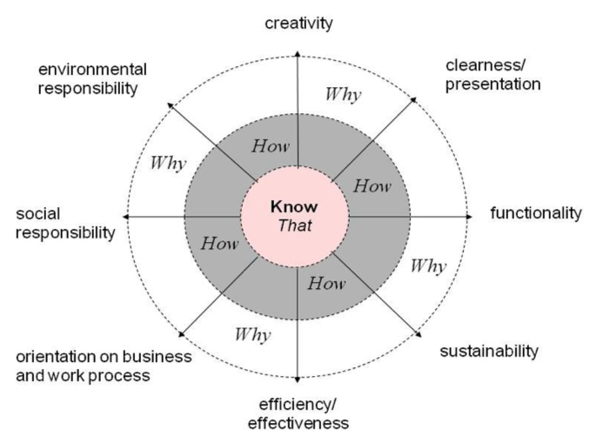
CREATING PATHWAYS….21ST CENTURY WORKPLACE
COMET OCCUPATIONAL COMPETENCE MODEL
(Rauner, 2011, p. 25)

Slide 8
COMET – THREE DIMENSIONS – DIDACTIC VEHICLE FOR 21st Century TVET
(Rauner et al. , 2013, pp. 41-52)

Slide 9
RESEARCH DESIGN AND METHODS
PARTICIPANTS : 715 Students and Artisans - 6 Public TVET Colleges (7– campuses); 3 Industry Training Academies; 2 Private TVET Colleges
Male-69, 1%; Female -26,1%; No response – 4,8%.
Dominant age group: 21-25
STUDY PROGRAMMES: Mechatronics, Millwright, Welding and Electrical.
Quantitative and Qualitative research – Mixed method – Explanatory Sequential Design
DATA COLLECTION METHODS:
COMET Large-Scale Open-ended Test Task assessment
FOUR CONTEXT QUESTIONNAIRES: Assessment Feedback; COMET Occupational Commitment and Motivational; Social competence
Qualitative focus group interviews.
DATA ANALYSIS: SPSS ; COMET psychometric model; Descriptive statistics
COMET Raters identified and trained.
Test Task validity was established.

Slide 10
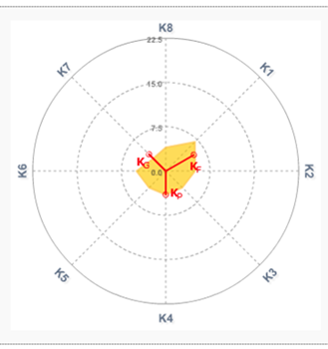
COMET LARGE-SCALE ASSESSMENT –PROBLEM SOLVING COMPETENCE LEVELS - TVET

Slide 11
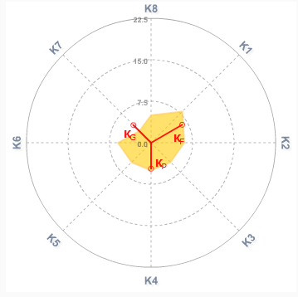
WORK PROCESS KNOWLEDGE- Critical element for 21st century workplace
K1-Clarity/Presentation K2-Functionality K3-Use value K4-Cost Effectiveness K5-Business /Work Process K6-Social Responsibility K7-Environmental Responsibility K8-Creativity Kf-Functional Competence Kp-Processual Competence Kg-Holistic Shaping Competence

Slide 12

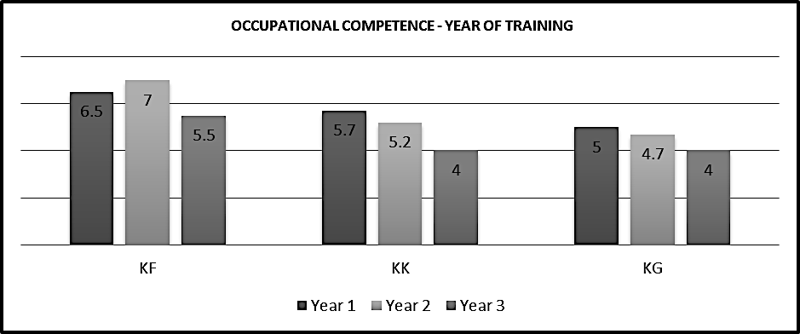
Occupational Competence Median Scores According To Year of Training – Stagnation of competence

Slide 13
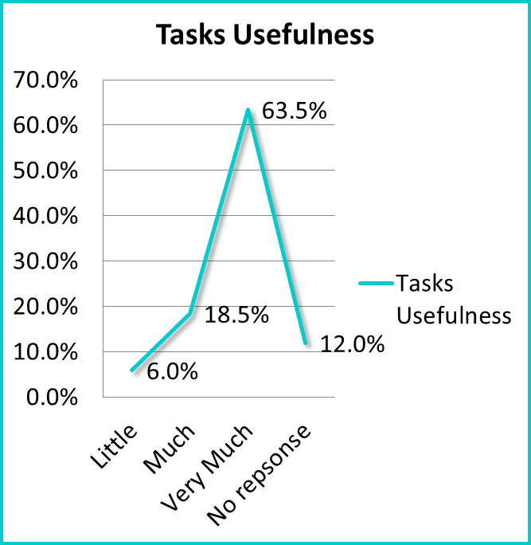
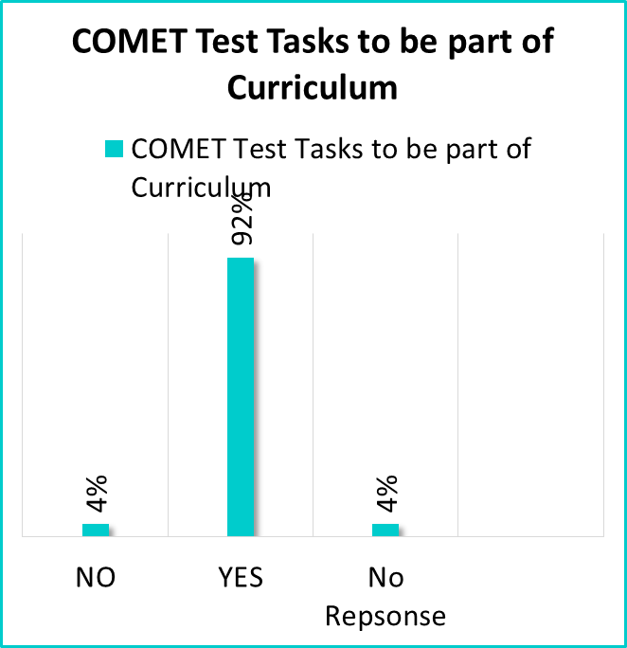
STUDENT MOTIVATION AND COMMITMENT

Slide 14

CONCLUSION- implications for 21st Century demands and opportunities
Poor holistic problem solving competence (11.4%) - a threat to the high expectations of TVET.
Workplace-based learning(DSAP) on the development of occupational competence in students and most probably lecturer competence.
The drop in performance from K1 (Presentation) to K2 (Functionality) is proof of the emphasis on the theoretical part of their current curriculum.
Little evidence of a fundamental didactic principle of COMET-accumulative competence-novice to expert level is observed- stagnation in problem solving competence over the three years of training.
Significant evidence of diversity.
Poor Work Process Knowledge (Know-That level) – contrast to high expectations of TVET.
Poor occupational competence levels vs high motivation levels – concern.

Slide 15
SWOT ANAYSIS FOR SKILLS DEVELOPMENT IN SA
STRENGTHS Policy and Strategy directives White Paper for Post-School Education and Training: The most important indicator for the success of a (TVET) college is the quality of education offered by a well-educated, capable and professional teaching staff (DHET, 2013, p. 16). NDP/ NSDS III/ OECD/ ILO/SADC, etc. High motivational levels of students Resources – e.g. 50 TVET Colleges | WEAKNESSES Fragmented approach wrt Skills development/TVET- curriculum vs 21st century demands/opportunities Didactics in TVET Feedback / feedforward structures Poorly developed support structures – SSS/ WIL etc. Staff qualifications relevant to job demands Literature/Numeracy (LIT/NUM) skills of students Insufficient emphasis on occupational competence and commitment development
OPPORTUNITIES Improve quality assurance processes in TVET/Skills Apply sound didactic principles such as COMET model Re-generate thinking – TVET Open field for Research Career Guidance QCTO/TVET collaboration Skills/TVET delivery addressing youth unemployment and exclusion Holistic development of occupational competence and commitment Integrated support for students Innovation/Entrepreneurship Allign Skills/TVET delivery to 21stcentury realities/workplace | THREATS Teaching to Test - TTT Hidden Curriculum Applied Curriculum Poor occupational competence levels in TVET Poor holistic problem solving competence Gender inequality TVET being perceived as a fallback position. Job-man-fitness Occupational Competence - stagnation Insufficient practical real work experience of students TVET seen as fallback position Student work readiness

Slide 16

THANK YOU
Last word from students……
Big Difference. Curriculum Tasks at college are not scenarios. You just do theory. With COMET you must think more, do a lot of research. You must do a lot of stuff such as being creative while at normal college work you study the text book and you give it back. We are not use to this type of (holistic problem solving) thinking.
With COMET, you also need to understand how the outside world works.
The Skills/TVET curriculum must be rooted in sound didactic principles where Students’/Apprentices’ occupational competence evolve from a novice to an expert level within a well-developed and accomplished (COMET) didactic approach in TVET.

