Slide 1


Progress of Skills for and through Strategic Infrastructure Projects
Presentation by
Adrienne Bird and Emmanuel Baloyi
Special Projects Unit
Department of Higher Education and Training
23 March 2017

Slide 2
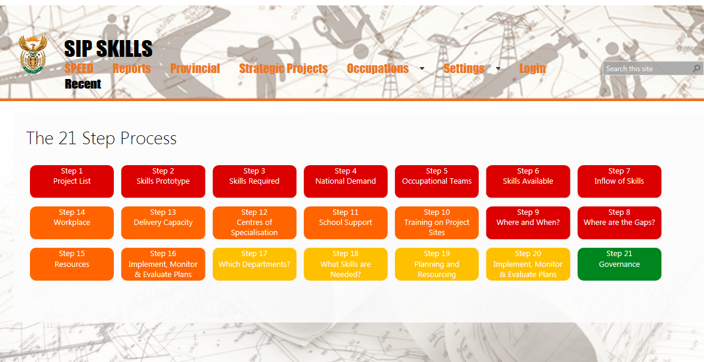
https://sip-skills.onlinecf.net
ESTABLISH DEMAND FOR SKILLS & SCARCE SKILL LIST
PLAN TO DEVELOP SCARCE SKILLS
RESOURCES & M&E
ADDRESS CAPACITY OF THE STATE
GOVERNANCE

Slide 3

PROTOCOL
PROTOCOL CLAUSES:
Preamble
Interpretations and definitions
Commencement and duration
Obligations of the DG of dhet
  Provide training in 21 steps
  Provide portal and support its use
  Occupational teams etc.
Obligations of the DG of the Premier’s Office
  Appoint manager
  Establish a Provincial Sip Skills Committee (reps per Steps)
Functions of the Provincial Sip Skills Committee
  Implement 21 steps in the province
Other legal matters

Slide 4
Provincial Sip Skills Committee
Membership
Chairperson (Province)
Steps 1-3 Province planning office reps
Step 6 STATSA / DOL
Step 10 cidb
Step 11 DBE and career development
Steps on supply side – DHET reps
Steps 17 – 20 DPSA/COGTA/MISA/NT
Step 21 Project manager
Support staff: IT; communications, secretariat
Functions
Prepare a plan
Determine priority occupations
Engage with providers to address gaps (colleges, universities, SETAs etc.)
Set targets
Unblock challenges
Employer campaigns for workplace learning (with SETAs)

Slide 5
Steps 1 – 3
Step 1 Compile project lists
Step 2
Typical skills for project types
Step 3 Estimate skills needed & scarcity
SCARCE SKILLS LIST
(which ones?, how scarce?)
Managers
Professionals & associate professionals
Service and clerical workers
Artisans
Plant and machine operators
Elementary skills

Slide 6
SCARCE SKILLS LIST : Trades for the SIPs … and more =
Priority trades required across ALL SIP (and other) projects
Phakisa
√
√
√
√
√
√
√
√
√
√
War on Leaks
√
√
√
√

Slide 7
Step 4
Step 5
Step 6
Step 7
Step 8
Step 9
Compare to national demand for the occupation
Steps 4 - 9
Check the numbers with occupational experts
How many people are working with this occupation now?
How many people are in training, now and anticipated in future?
How short are we going to be?
Geographically, where is demand strongest?

Slide 8
Step 10
Step 11
Step 12
Step 13
Step 14
Steps 10 - 16
Train on project sites (cidb Training Standard)
Career development in targeted areas (schools & NCAP)
Identify institutions to provide theory and practical
What capacity do these institutions need?
Step 15 – resources
Step 16 – Monitoring and evaluation
Secure workplace learning places (SETAs)

Slide 9
Priority trades
(with OFO codes):
641201 Bricklayer
671101 Electrician
671202 Millwright
651302 Boilermaker
642601 Plumber
653101 Mechanic including automotive mechanic
653306 Diesel mechanic
641501 Carpenter and Joiner
651202 Welder
651501 Rigger
652302 Fitter and turner
653303 Mechanical fitter
    642607 Pipe fitter
Steps 12 – 16 e.g. Major Centres of Specialisation Programme
Phase 1
Phase 3
the selected Centres of Special-isation will be ready for learner intake using the A21 value chain method
Phase 4
the number of successfully completed apprentice-ships in each of the priority trades developed
Phase 2
Contractual agreements between implement-ing parties in place for each selected college.
(i) a number of TVET colleges selected as Centres of Special-isation, and
(ii) a detailed implement-ation plan per CoS selected college developed

Slide 10
Steps 17 - 20
Building the capacity of the state
DPSA
COGTA
Province
MISA
NT
Infrastructure Delivery Management System
National Infrastructure Maintenance Plan

Slide 11
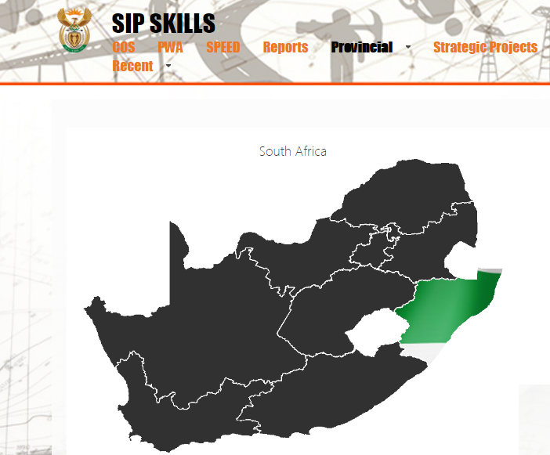

Kwazulu Natal
Work well underway
Step 1
Step 2
Step 3
Steps 4 to 9 in process
Steps 12 to 15 in process
Committees in place
Kwazulu Natal

Slide 12
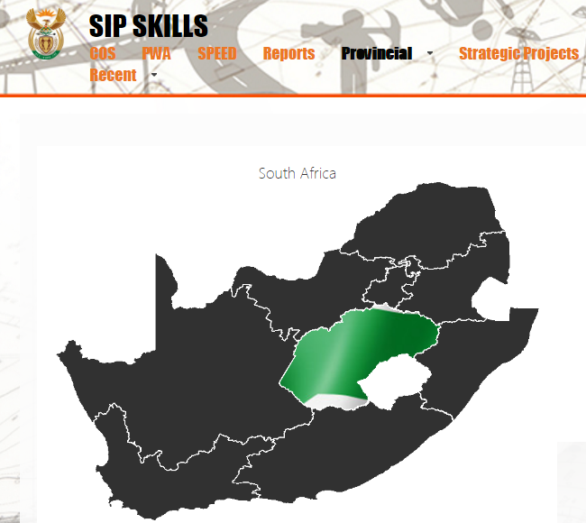
Protocol signed
Free state

Slide 13
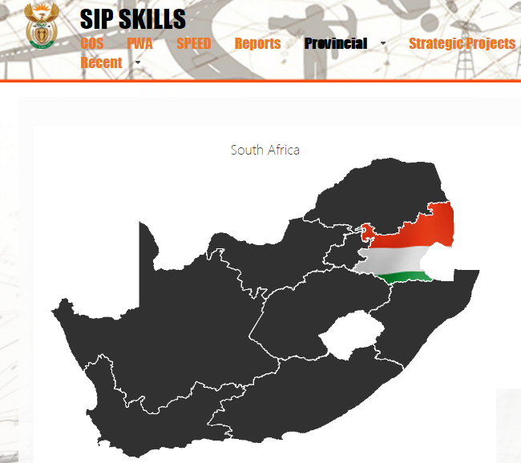
Protocol signed
Mpumalanga

Slide 14
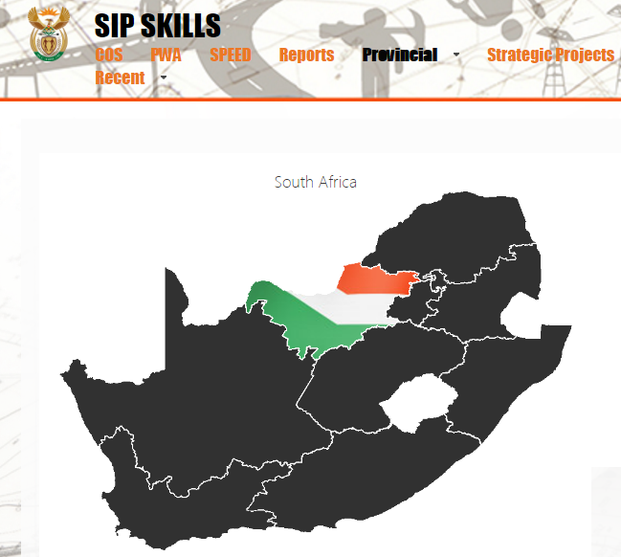
Protocol signed
North West

Slide 15
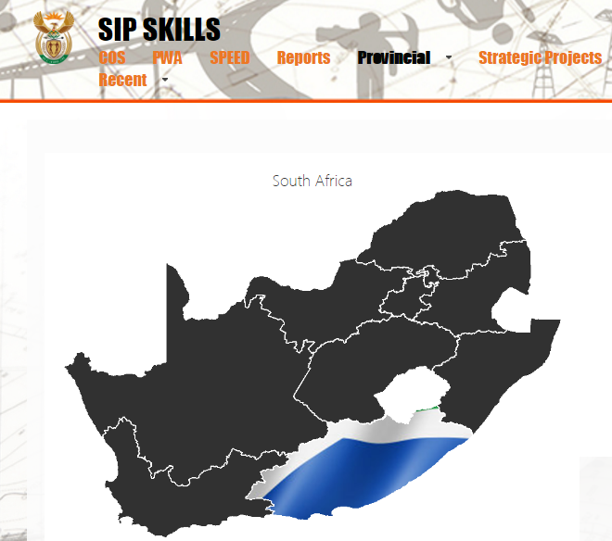
Protocol signed
Eastern Cape

Slide 16
Thank you
https://sip-skills.onlinecf.net

